Slide 1
UML DIAGRAMS
Ashish Bhatia-U17CO076
Raghav Laddha-U17CO083
Kalp Panwala-U17CO085

Slide 2
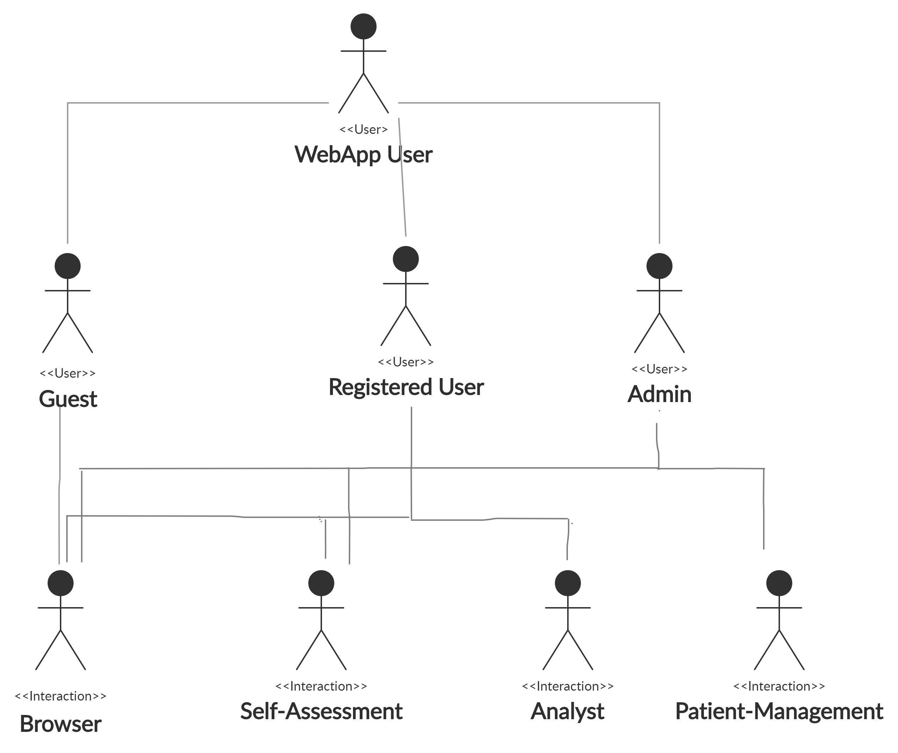
1.UML Actors

Slide 3
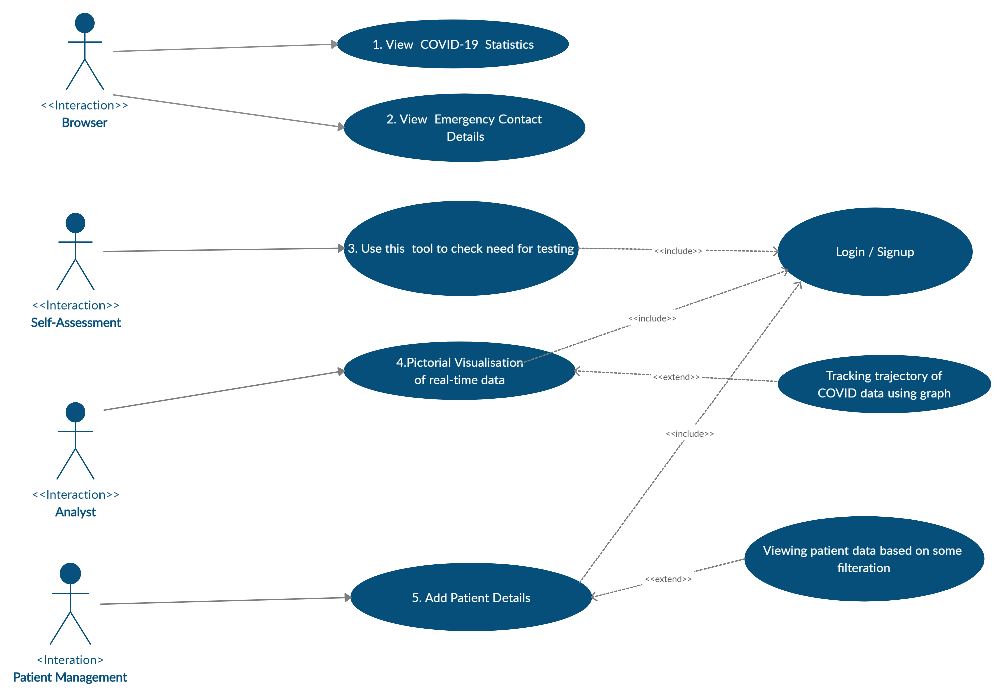
2.UseCase Diagram

Slide 4
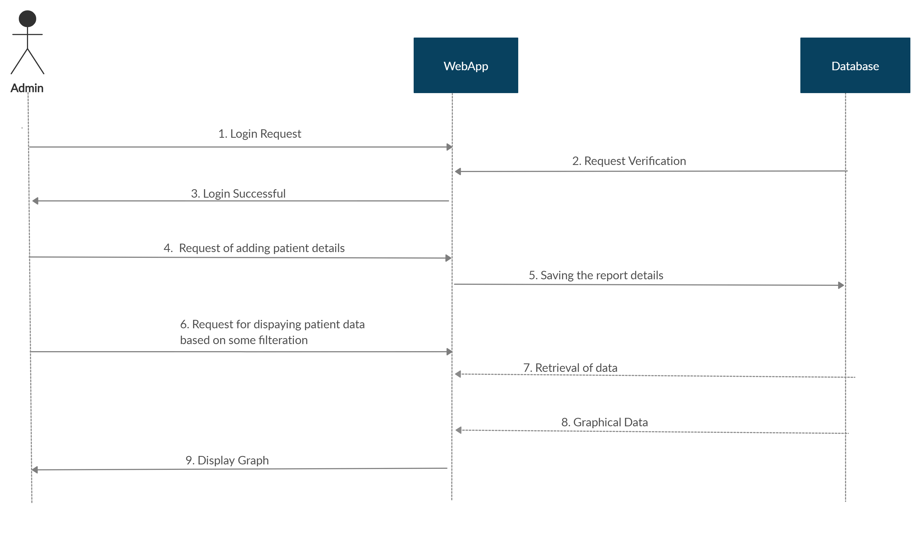
3.1 Sequence Diagram

Slide 5
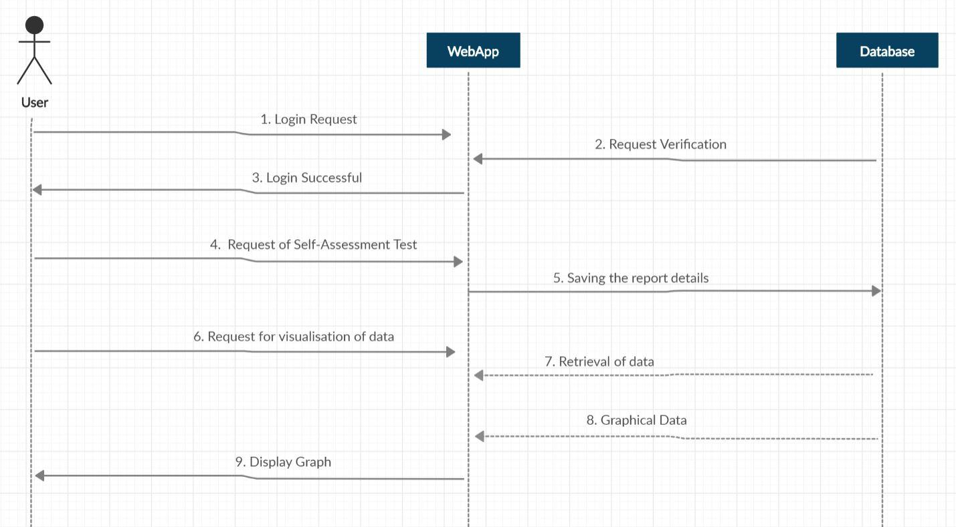
3.2 Sequence Diagram

Slide 6
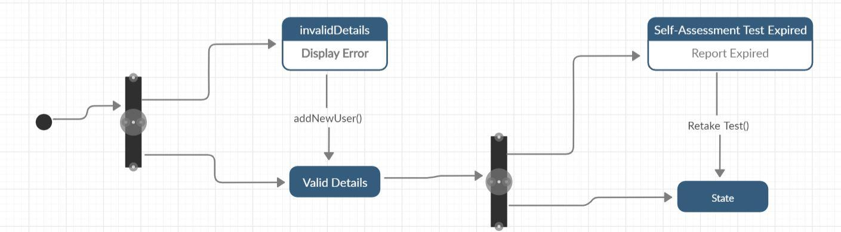
4. State Diagram

Slide 7
Thank You

